Slide 1
Craigslist House Listing Mongodb Project
Submitted by:
harshal bendale
Archit Jain
Vidhi shah
Gurkiranjot singh

Slide 2
Table of contents
INTRODUCTION
TECHNOLOGY
METHODOLOGY
APPLICATION
CONCLUSION

Slide 3
INTRODUCTION
Craigslist House Listing MongoDB Project as the name suggests is an application to show listings of houses on craigslist.
The user friendly app that helps the user to search the listings of his/her liking from a large dataset.
This application utilizes MongoDB database and the front end has been designed using HTML and JavaScript.
The app displays the detailed information about the listing under different attributes like price, type, parking options, region, description, image, etc.

Slide 4
TECHNOLOGY
DATABASE :
MongoDB : Flexible and being easy to scale were the main reason behind choosing MongoDB.
APPLICATION DEVELOPMENT
JavaScript : Familiarity to the technology due to class exercises.
HTML : Easy to understand and develop.
CLOUD :
MongoDB Atlas based on AWS.

Slide 5
methodology
Data Preprocessing :
The dataset was chosen from website called Kaggle.
Due to limited space in cloud only 198k unique listings with housing details spread over 22 attributes were used.
25 images of the houses were added to GRID-FS.
Record with missing longitude and latitude values were deleted.

Slide 6
Database creation:
CSV file of dataset was uploaded using MongoDB Import (csv) command from PowerShell.
Pictures of houses were upload in Grid-fs on cloud using a script file. (Only 25 were uploaded due to size constrains)
Back is hosted on cloud using MongoDB stich which is server less – Back-end as Service.

Slide 7
Front end(client side) :
The JavaScript output was processed using the script tag in HTML.
The results are displayed using HTML.

Slide 8

application
HOME PAGE :

Slide 9

RESULT :

Slide 10
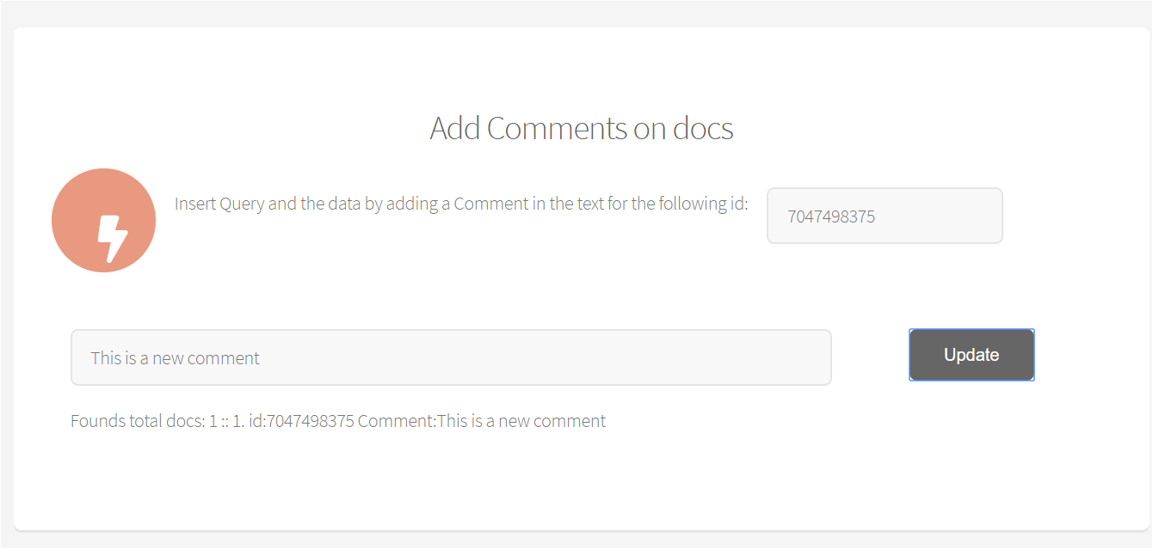
COMMENTS :

Slide 11
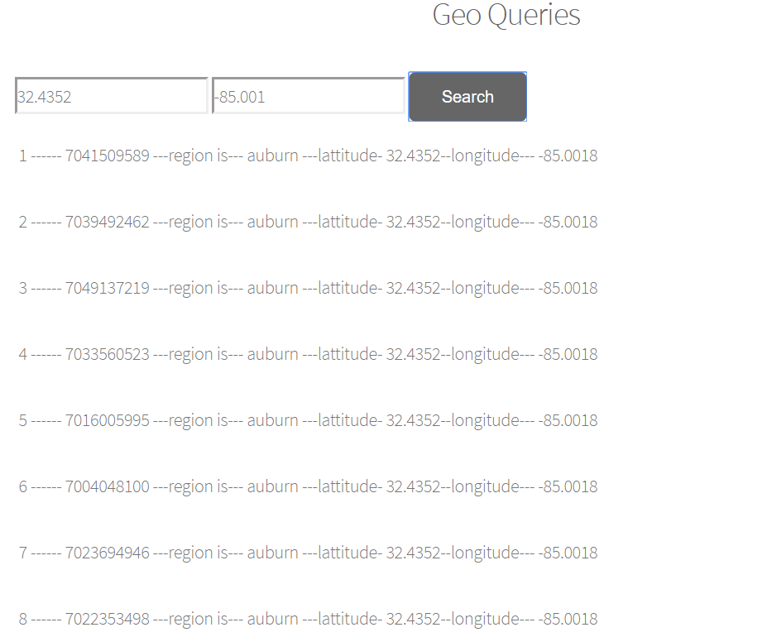
GEO QUERIES :

Slide 12
Conclusion
Application was developed.
User will be able to retrieve data and perform operation through a lightweight serverless application in conjunction with MongoDB atlas and stich platform.
MongoDB stich was found to be useful tool to make serverless cloud based projects.

